Slide 1
Joseph K. Vermeille, BS, MS, EDS, PhD My Academic Journey From 2025 To 1962 63 Years of Learning and Continuing at 68 As A Lifelong Learner...A Learner for Life! This is Not an Exhibition This is Only a Tentative Inspiration For the Vey Young and the Very Old (06-01-2025) The Message: Learning Never Ends!

Slide 2
Joseph K. Vermeille, BS, MS, EDS, PhD Mon Parcours Académique De 2025 à 1962 63 Ans d’Etudes et Continuant à 68 Ans En Tant qu’Etudiant Tout Au Long de la Vie... Un Etudiant A Vie ! Ce n'est Pas une Exposition, Du Chantage C'est Juste Une Tentative d’Inspiration Pour les Très Jeunes et les Très Âgés (06-01-2025) Le Message : L'Apprentissage Ne Finit Jamais !

Slide 3
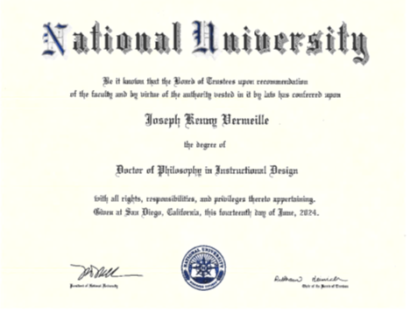

Slide 4
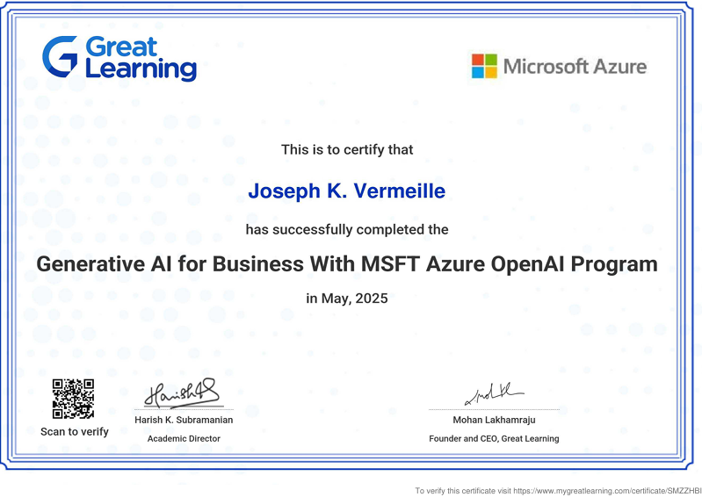

Slide 5
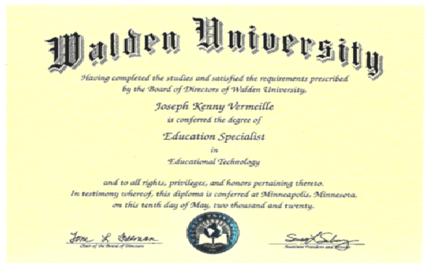

Slide 6
Temporarily Missing
Columbia University
Master’s Degree
Technology Management
2007-2009

Slide 7
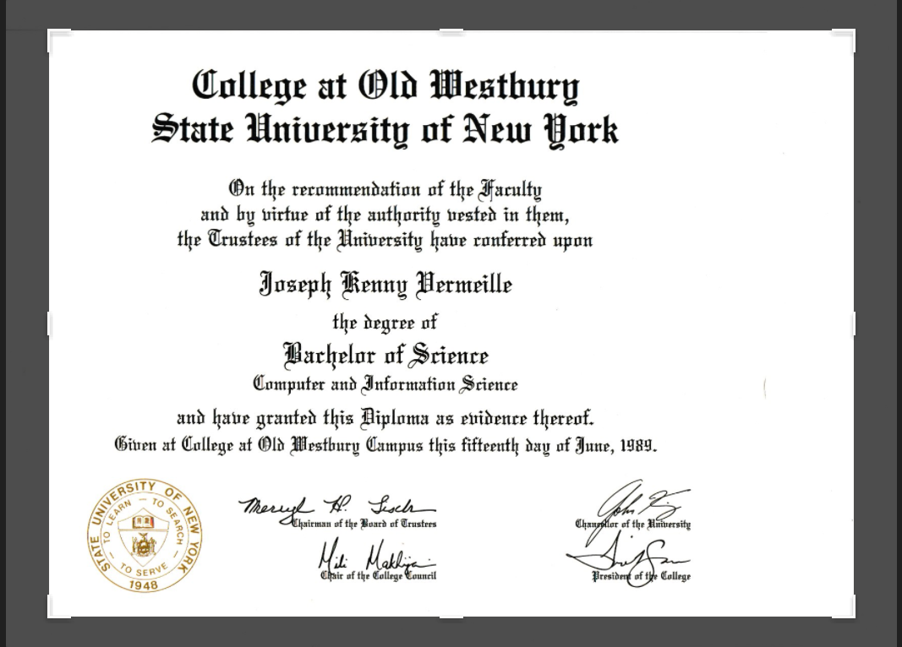

Slide 8
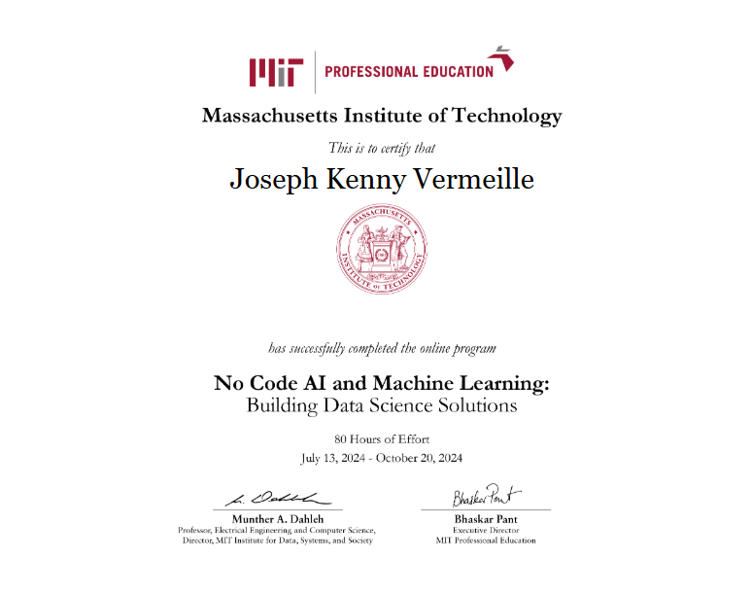

Slide 10
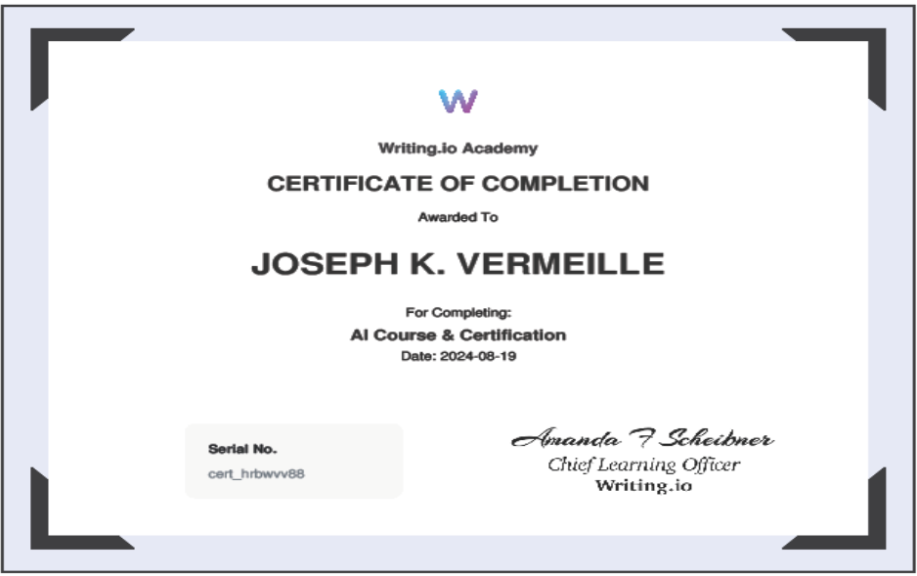
Training, Professional Development, and Achievement

Slide 11
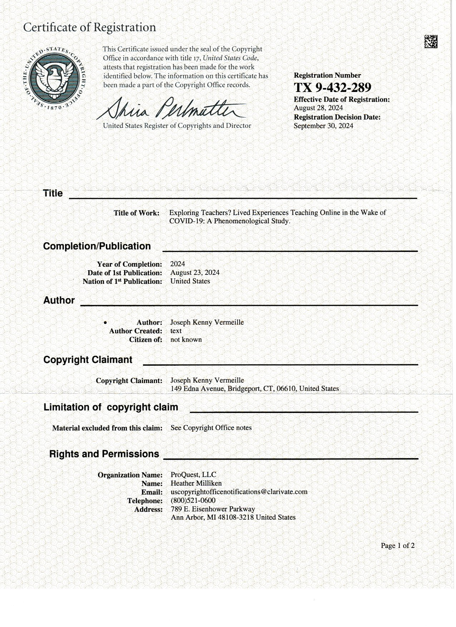
Training, Professional Development, and Achievement

Slide 12
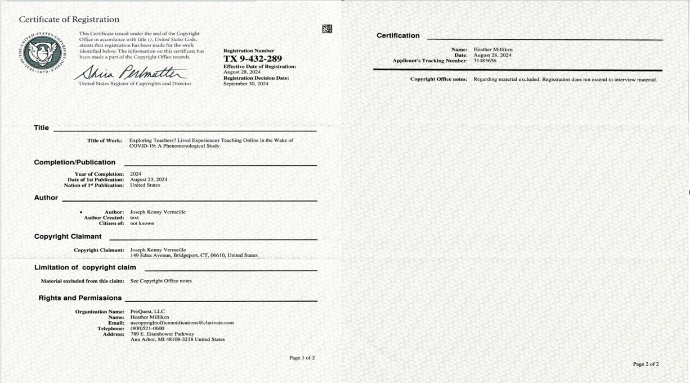
Training, Professional Development, and Achievement

Slide 13
Training, Professional Development, and Achievement

Slide 14
Training, Professional Development, and Achievement

Slide 15
Training, Professional Development, and Achievement

Slide 16
Training, Professional Development, and Achievement

Slide 17
Training, Professional Development, and Achievement

Slide 18
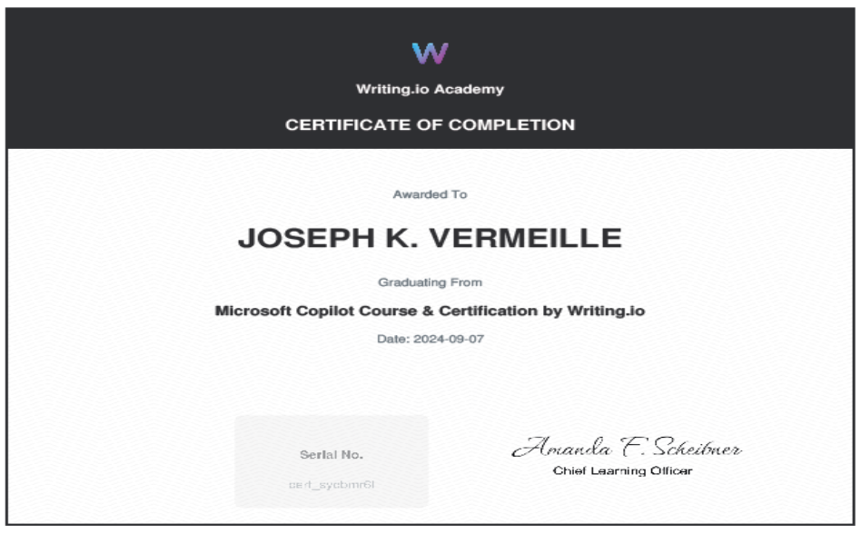
Training, Professional Development, and Achievement

Slide 19
Original In Progress
Certificate of Completion
No-Code AI and Machine Learning:
Building Data Science Solutions
Massachusetts Institute of Technology
(MIT-Great Learning)
2024

Slide 20
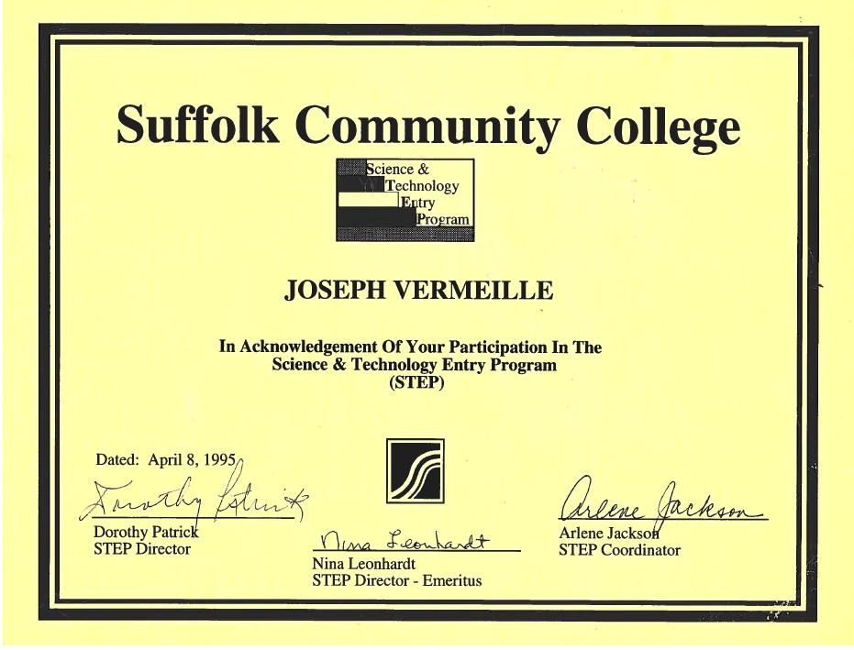
Training, Professional Development…

Slide 21
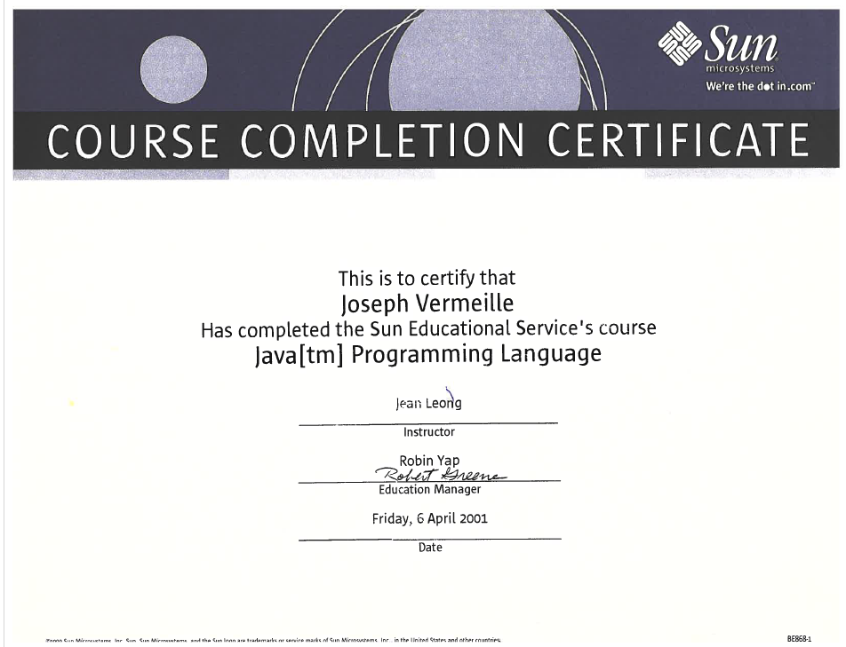
Training, Professional Development, and Achievement

Slide 22
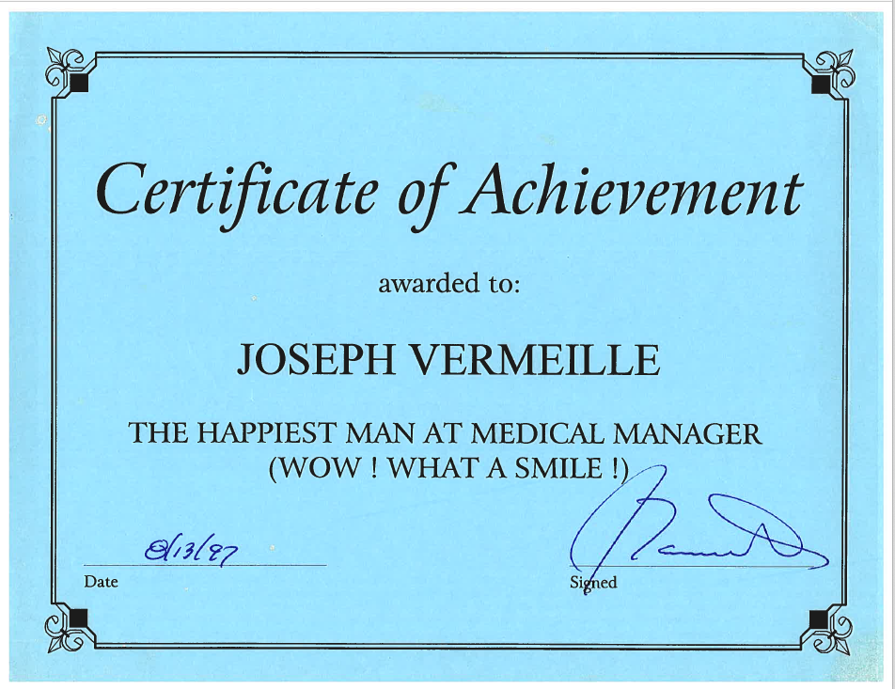
Training, Professional Development, and Achievement

Slide 23
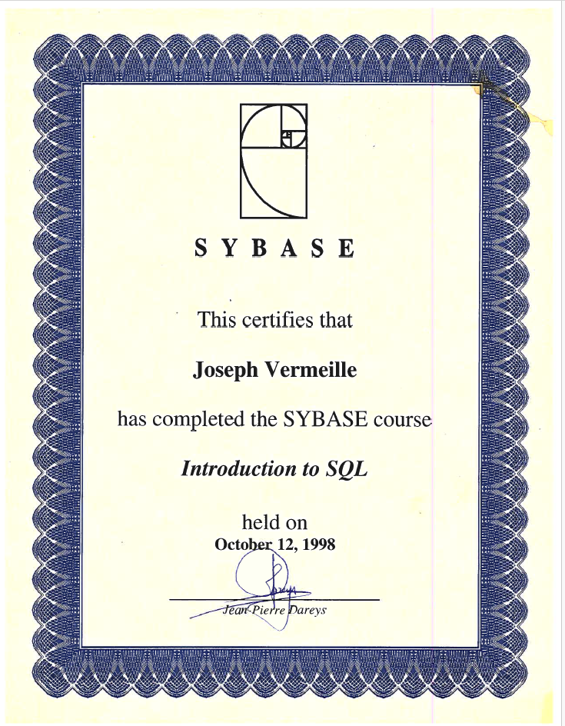
Training, Professional Development, and Achievement

Slide 24
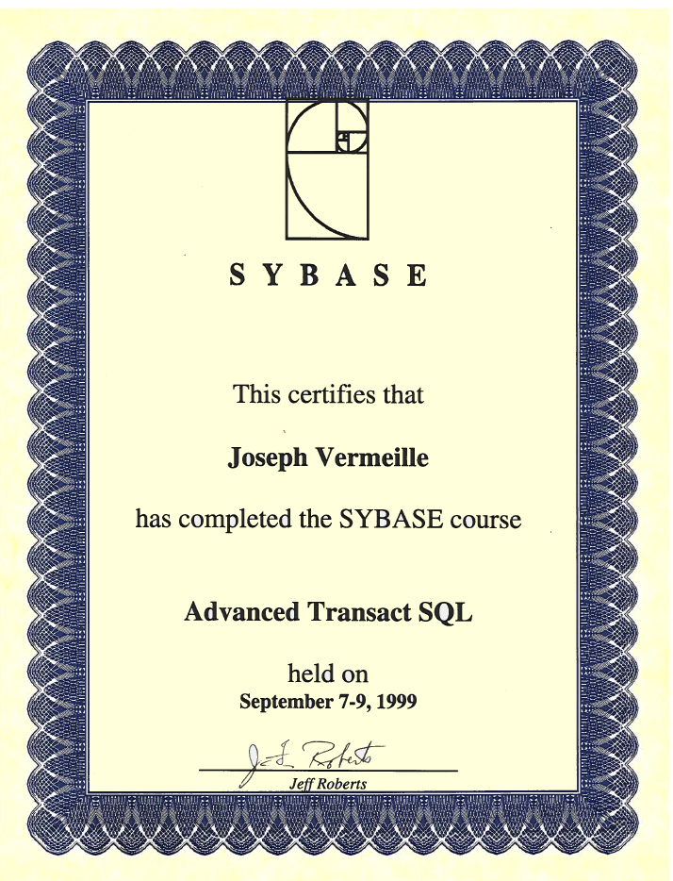
Training, Professional Development, and Achievement

Slide 25
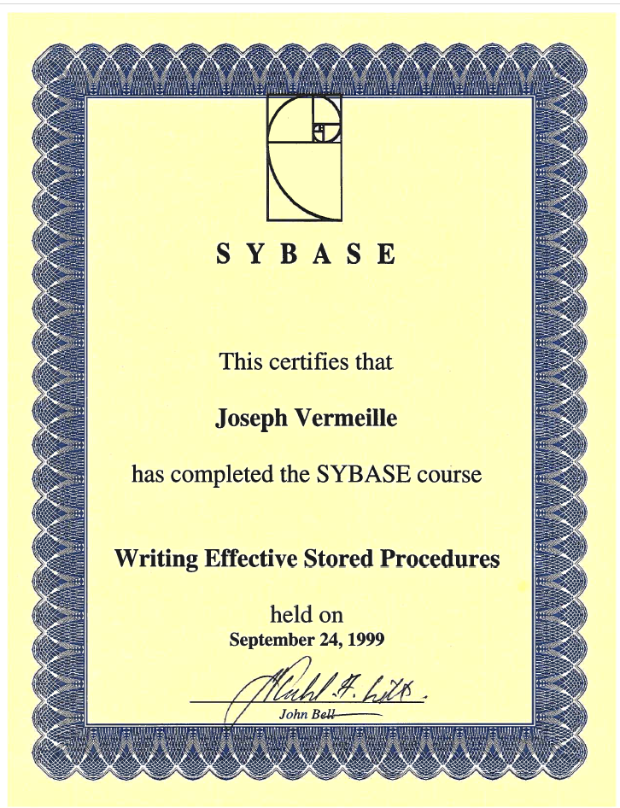
Training, Professional Development, and Achievement

Slide 26
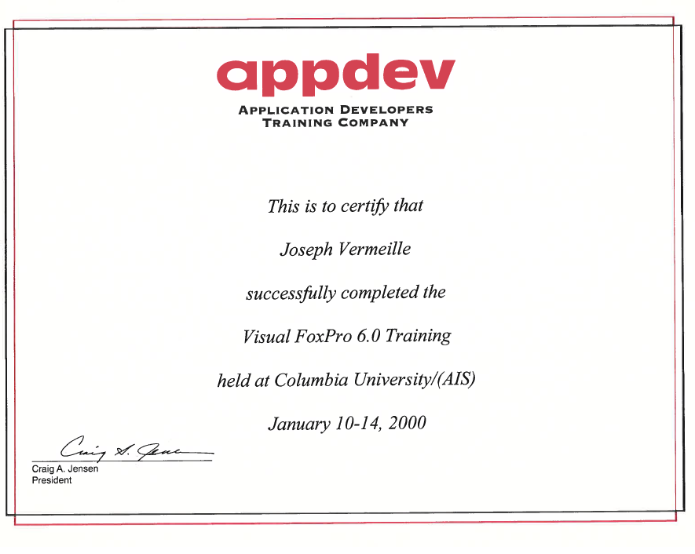
Training, Professional Development, and Achievement

Slide 27
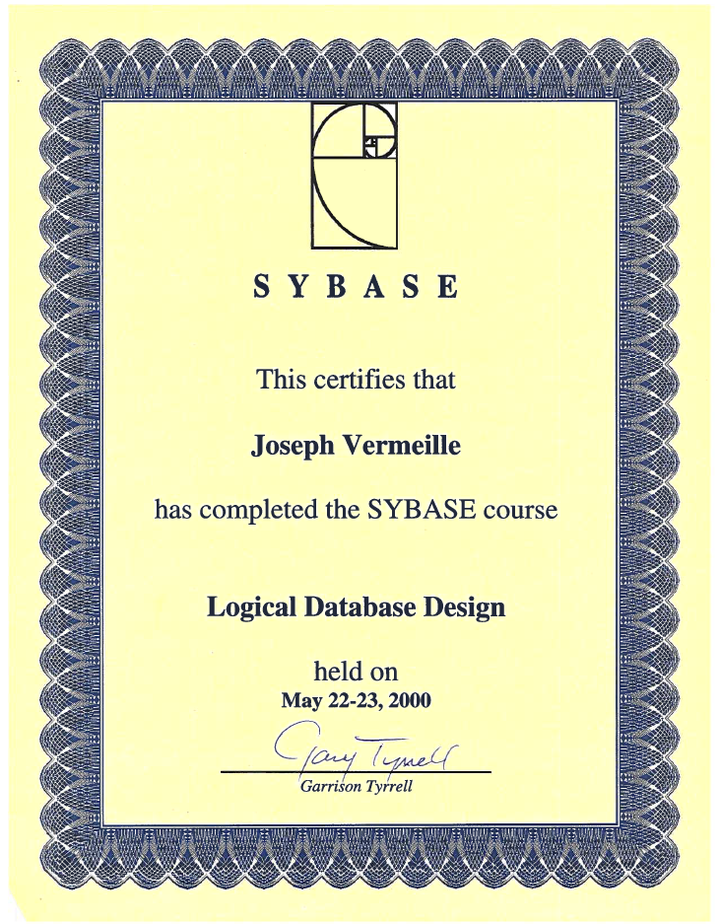
Training, Professional Development, and Achievement

Slide 28
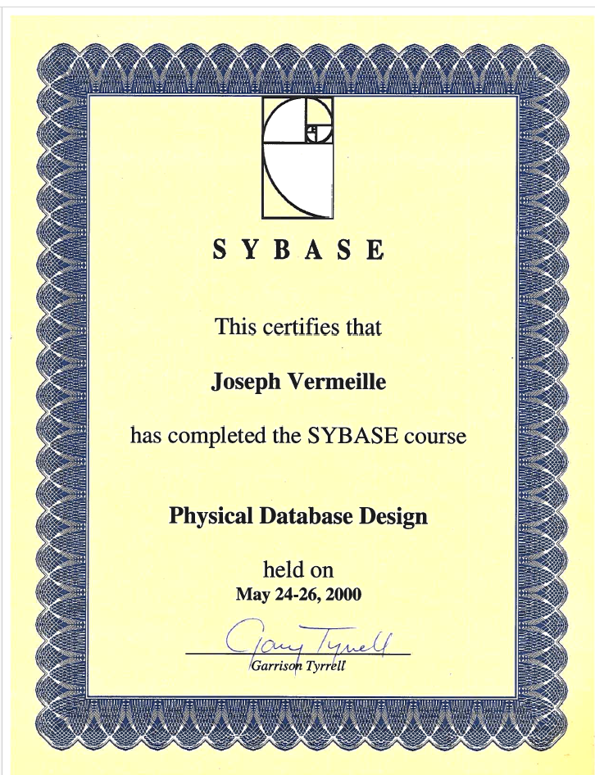
Training, Professional Development, and Achievement

Slide 29
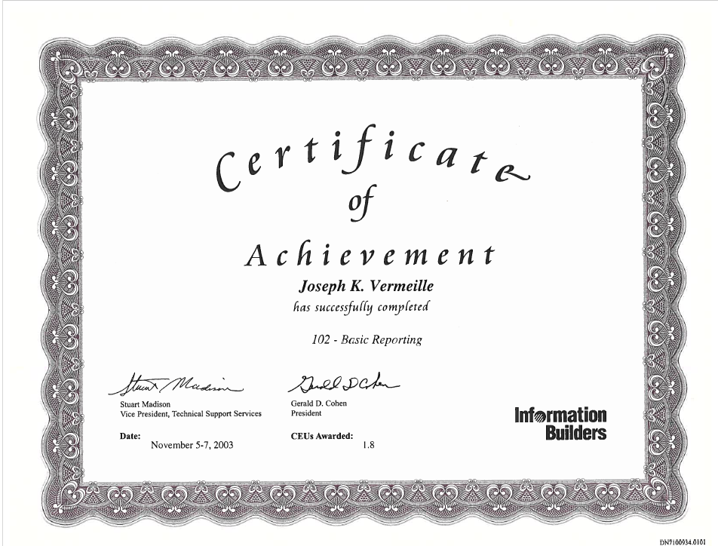
Training, Professional Development, and Achievement

Slide 30
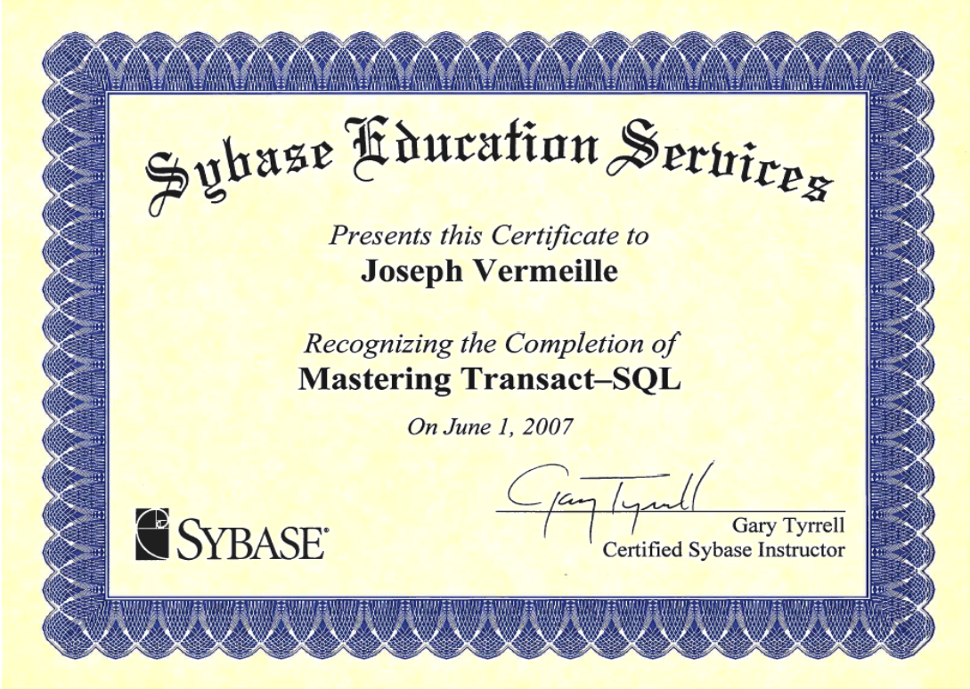
Training, Professional Development, and Achievement

Slide 31
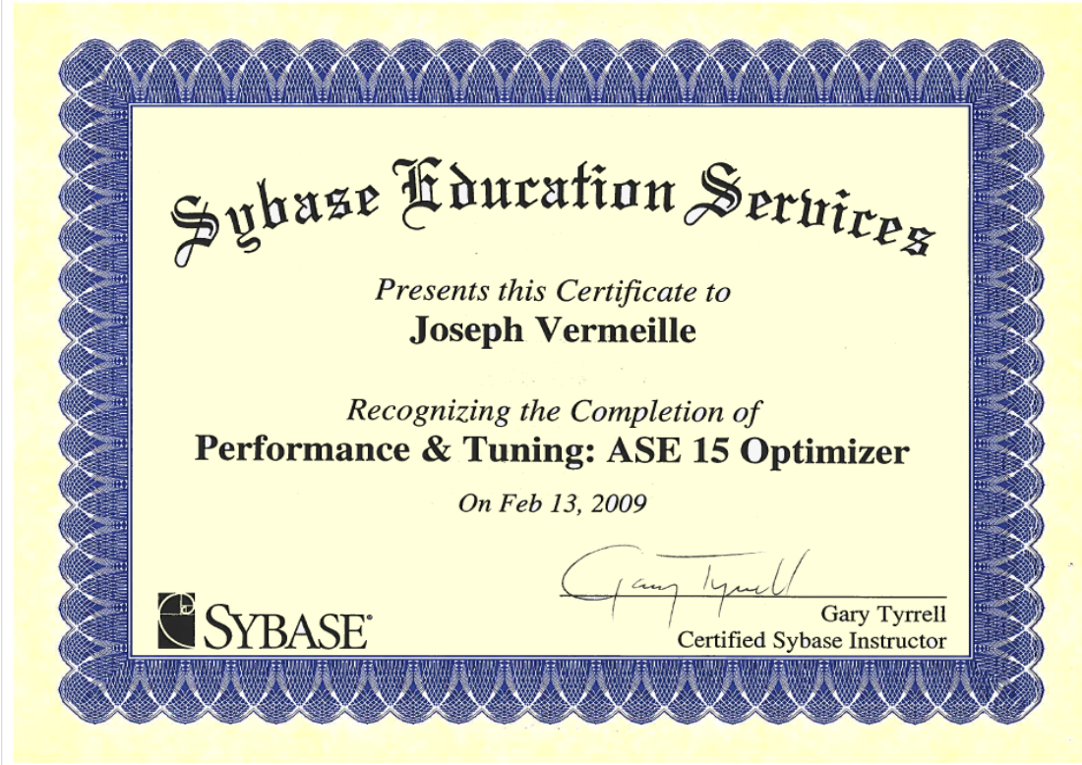
Training, Professional Development, and Achievement

Slide 32
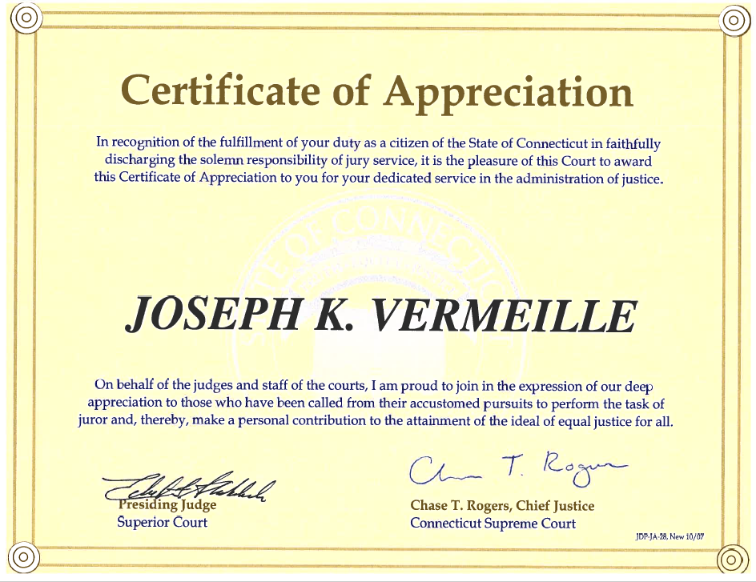
Training, Professional Development, and Achievement

Slide 33
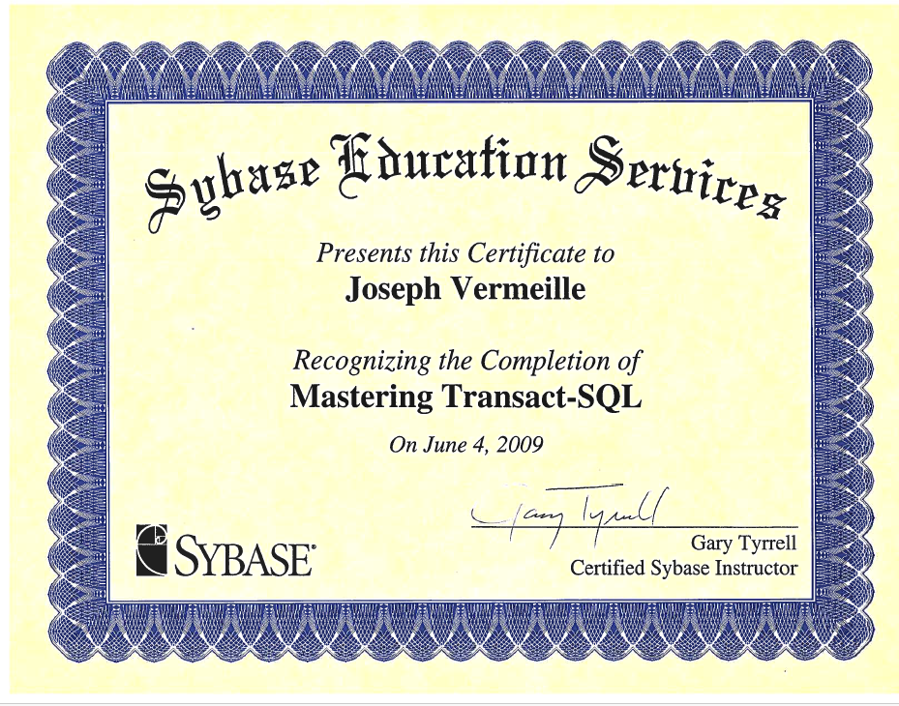
Training, Professional Development, and Achievement

Slide 34
Original Missing
Certificat d’Etudes Professionelles
Fiscalite et Comptabilite
Ecole Nationale d’Administration Financiere
Port-au-Prince, Haiti
Fiscal Management, Auditing
1978-1979

Slide 35
Original Missing
Certificat d’Etudes de Comptabilite
Ecole de Commerce Julien Craan
Port-au-Prince, Haiti
21st Century Accounting
1977-1978

Slide 36
Original Missing
Certificat de Fin d’Etudes Secondaires
College Saint Pierre
Eglise Episcopale d’Haiti
Port-au-Prince, Haiti
1971-1978

Slide 39
Original Missing
Certificat de Fin d’Etudes Primaires
Ecole Sainte Croix
Eglise Episcopale d’Haiti
Leogane, Haiti
1964-1971

Slide 40
Original Missing
Kindergarten
Ecole Epiphanie
Eglise Episcopale d’Haiti
L’Acul, Leogane, Haiti
1962-1964

Slide 41
Thank you
Joseph Kenny Vermeille
631-384-9304
DoctorVermeille@aol.com
www.DoctorVermeille.com
Thursday, October 3, 2024

